Slide 1

Identify neighbourhood locations based on Hospitals near by
Barath S

Slide 2
Business Problem
Hello! This is our problem where Four Square location data is applied to solve it:
Mr. John, 65 years old, has decided to move to a new apartment in city of Toronto with his wife, to one among the shortlisted places(Boroughs: )
Downtown Toronto
East Toronto
West Toronto
Central Toronto
As with old age, they have some pre-existing medical conditions and they need a location in the close vicinity of Hospitals for their treatment to be continued. Let us see the nature of treatment to shortlist hospitals.
Mr. John is a Heart Patient and his requirement is that the new location should be nearer to Heart speciality clinics.
Mrs. John has been visiting Toronto General Hospitals for past few years and she needs atleast one among these hospitals accessible from the new location.

Slide 3
Data
Data used:
The Toronto neighbourhood data was extracted from their Wikipedia page
https://en.wikipedia.org/wiki/List_of_postal_codes_of_Canada:_M
Data Structure:
The above data had three columns – Postal Code, Borough and Neighbourhood of Toronto.
We can see many NA values in them, and they were be cleaned.
We processed only the cells with an assigned Borough and removed the rows if Borough Column had NA values.
More than one neighbourhood can exist in one postal code area.

Slide 4
Methodology
Overall Process – Flow:
Data Extraction, Cleaning and Visualization
Map Creation and Plotting the initial scope
Using Foursquare API to get the venue data
Analyze each neighborhood by grouping the rows by neighborhood and set the final scope
Plot neighborhoods that contain the geolocations of interest
Suggest area nearest to visit places geolocations

Slide 5
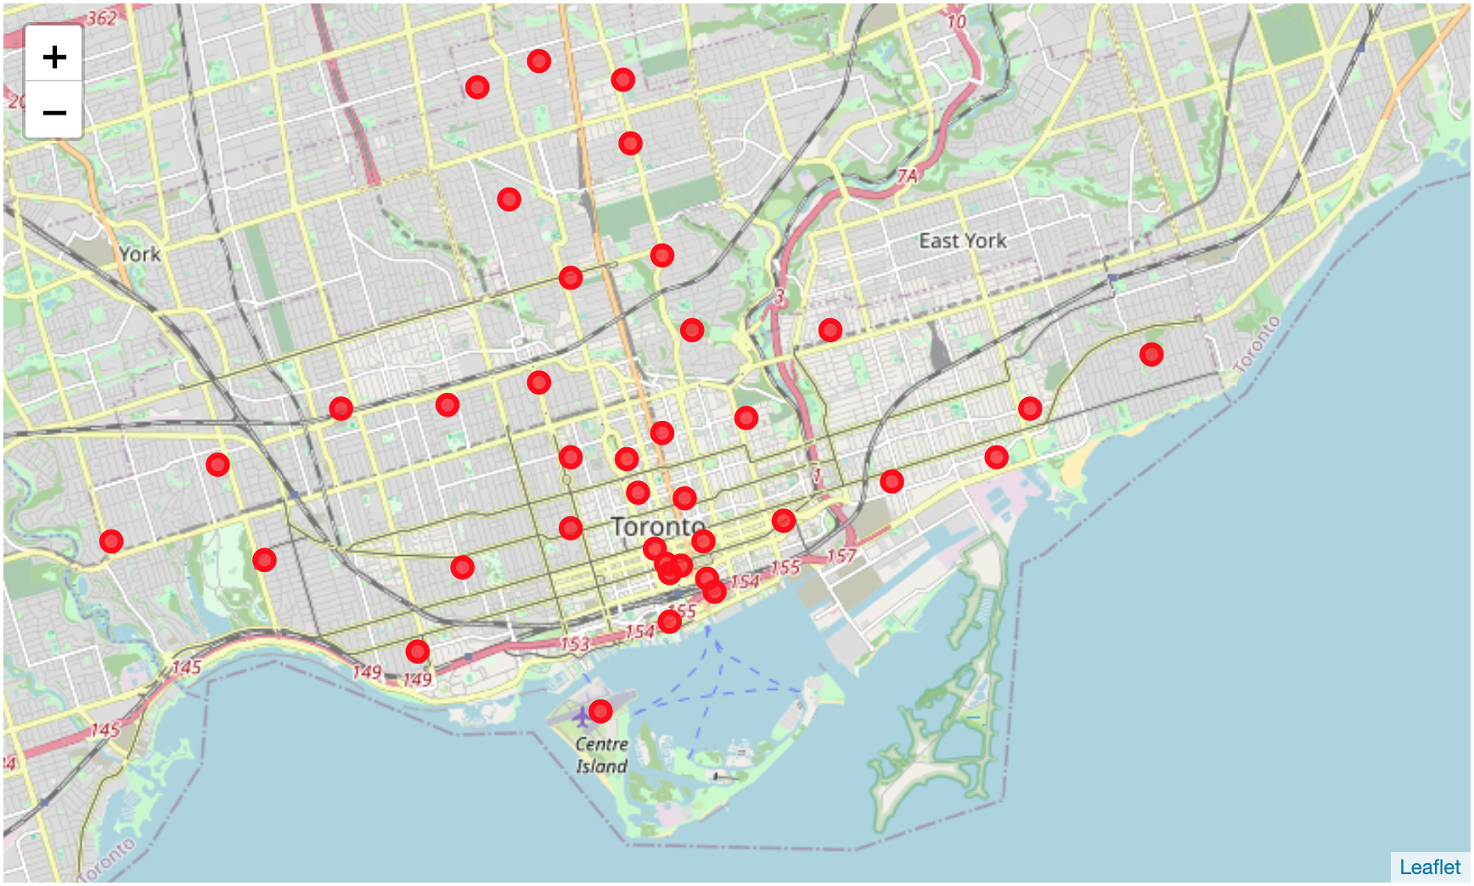
Methodology
Inference through Exploratory data analysis:
Toronto is a city, and It has large areas called Boroughs and multiple Neighborhoods in each borough.
The key process was to shortlist the locations based on various scenarios:
Areas without boroughs values from Wikipedia extracted data were removed
4 Boroughs from the Given conditions were filtered – Central Toronto, Downtown Toronto, East Toronto and West Toronto and plotted to infer initial scope.

Slide 6
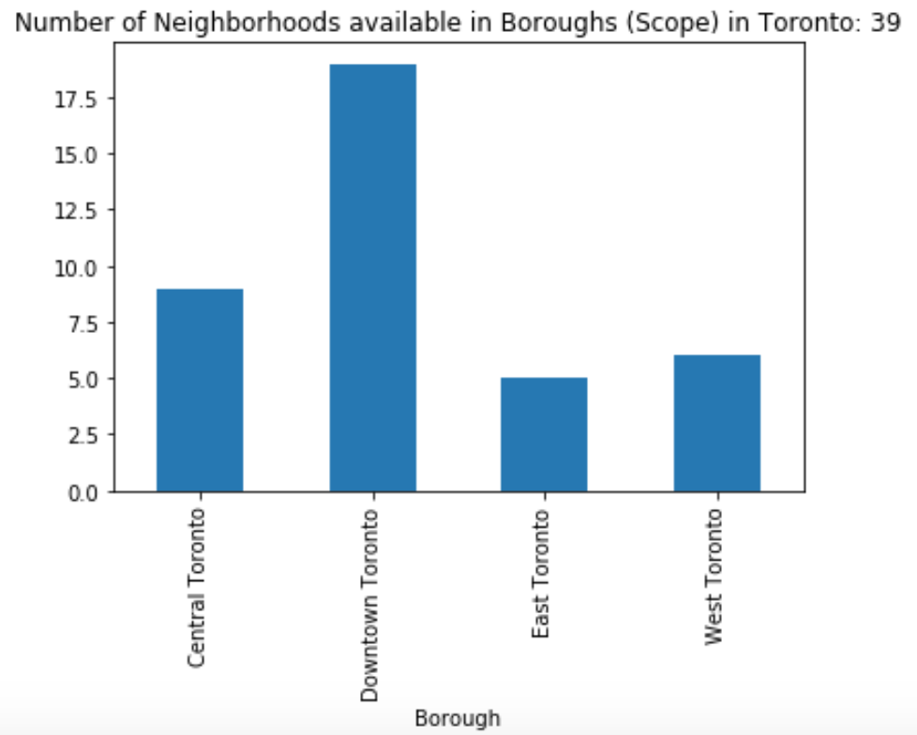
Methodology
Inference through Exploratory data analysis:
The distribution of neighborhoods among filtered boroughs can provide a good clarity to select one. So, it was also plotted.
We inferred that Downtown Toronto contained maximum number of neighborhoods.

Slide 7
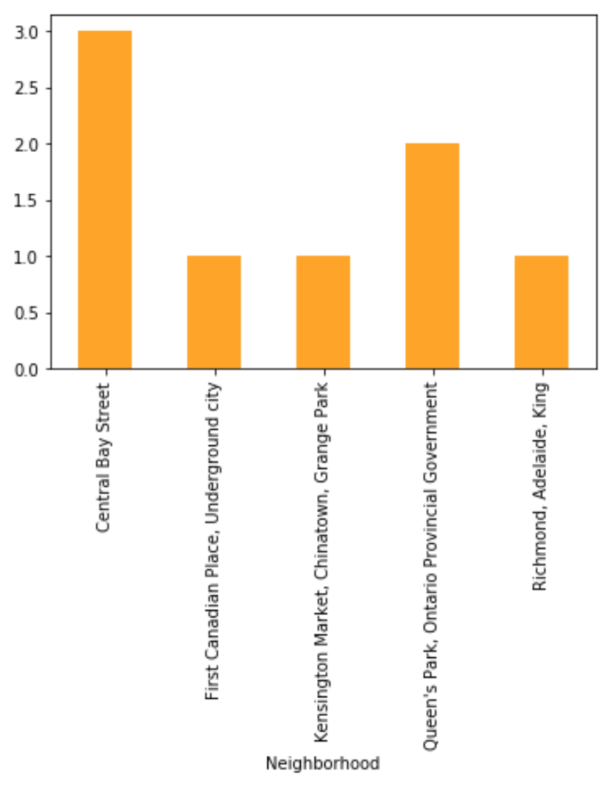
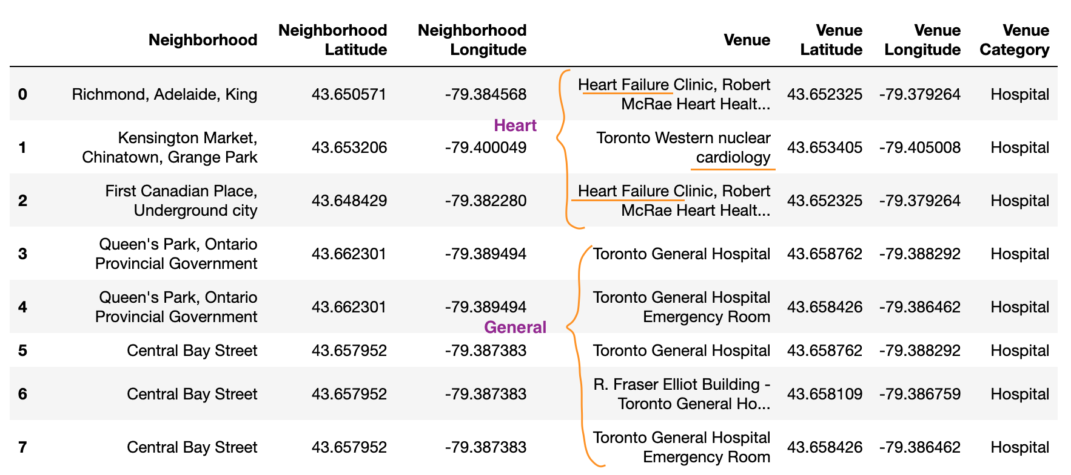
Methodology
Inference through Exploratory data analysis:
Taking this as a reference the Heart specialty clinics and General hospitals(from Problem Statement) were taken in turn and these were the locations plotted.
We infer Central Bay and Queens Park covered the requirements.

Slide 8
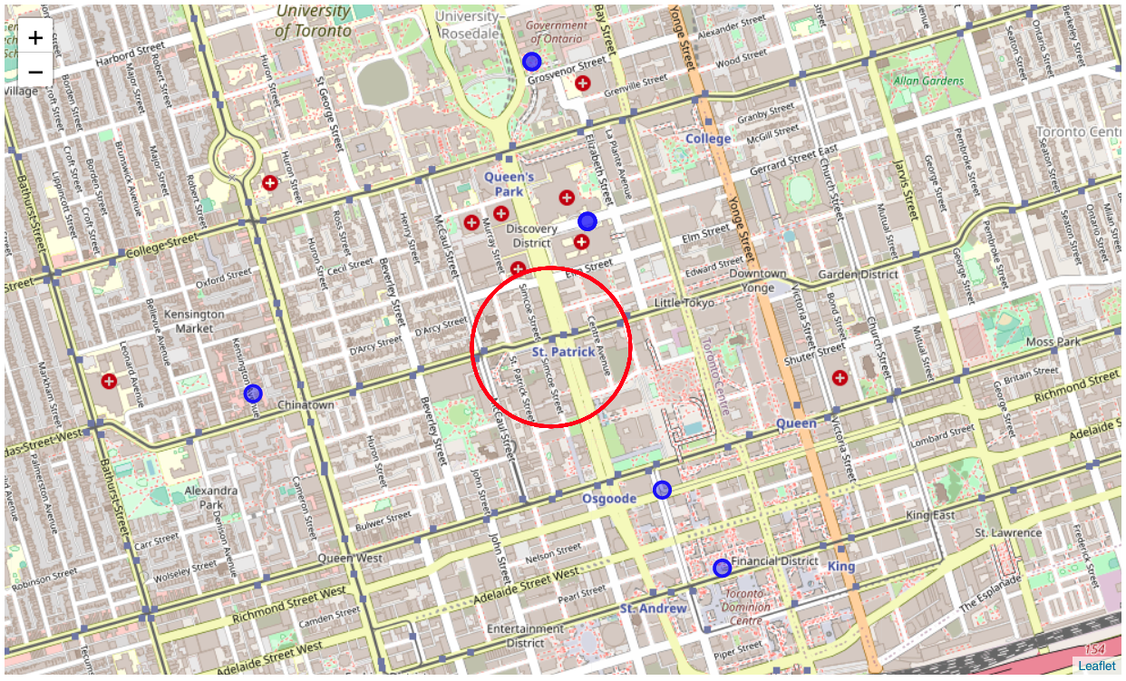
Results
The Geo locations of the neighbourhood containing the Hospitals were plotted.
The nearest neighbourhood to all these places was established as one of the solutions to this problem.
We can see that St. Patricks near Central Bay area would be a great neighbourhood.
From here both Heart Speciality Clinics and Toronto General Hospitals are conveniently accessible.
Mr and Mrs. John would be happy to move to this kind of a place.

Slide 9
Discussion
How was nearest neighbourhood calculated ?
The nearest neighbourhood was calculated as the centroid of the geo locations of the neighbourhoods containing the Hospitals.
Why? Why was Haversine distance not applied ?
As our locations in this particular area are not very far from each other, we can roughly consider earth as a plane and estimated the new location by determining the centroid of the surrounding geo location coordinates.
This would be the simple yet effective recommendation.
What are key improvement areas for future?
We can plot all neighborhoods from all boroughs to select the best one.

Slide 10
Conclusion
This project was the First attempt in Data Science - to apply Four Square Location Service provider API to solve a problem we created – to shortlist a location based on Hospitals near by.
A simple and effective tool for exploring of any geographical location was witnessed.
This can be extended to many use cases and help people in future.
Thank you!

